Slide 1

Changing your Password in VAdata
VAdata: Virginia’s Sexual and Domestic Violence Data Collection System

Slide 2
What is this New Password Process?
A designated person within your agency can now make password changes instantly!!
VAdata Admins will still be here to help if you get stuck, but the power is in your hands!
NOTE: This change will only apply to the VAdata system and not the Hotline messaging system. You will still need to contact a member of the Hotline team to change your password on that system.

Slide 3
Why Are We Changing the Process Around Passwords?
We want to increase agency autonomy as well as ease of updating passwords when agencies need those changes made quickly.

Slide 4
What Happens When a Request is Made?
Whenever a password change request is made, your agency’s designated VAdata contact person will receive an email about the request and will need to follow the steps outlined in this module to make the change.
This process is not like the “Forgot My Password” process in many other systems. Individual users are not able to enter an email address to which a change request will be sent.
Individual users should not submit password change requests without first consulting with their agency’s designated VAdata contact person or Executive/Program director. These are the only people who will be able to access the link to make the change.

Slide 5
Why is it Set Up this Way?
This protocol is in place to prevent password changes occurring without the knowledge of a person within your organization who is authorized to make that decision.
When we move to individual login information and an agency-level system administrator, we will implement a more user-independent system.

Slide 6
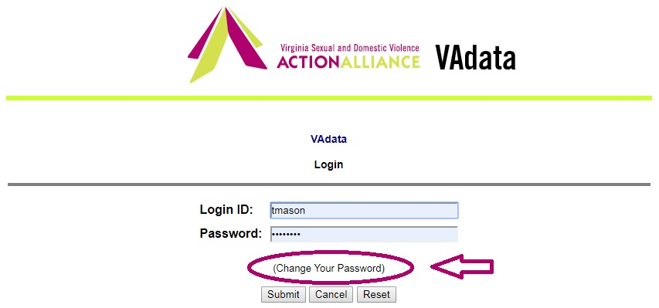
What Does the New Process Look Like?
For starters, you will notice a new clickable option on the login screen.

Slide 7

You will also notice a new option at the bottom of the main menu screen called “Manage Account”.
You can submit a password change request here as well.

Slide 8
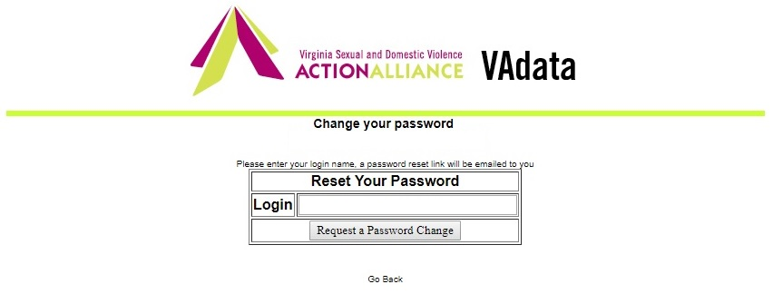
The Process
To change the password, click the “Change Your Password” link from the login screen or “Change Password” from the main menu.
This will take you to another screen where you will be able to enter your agency’s login name.

Slide 9
After you enter your agency’s login information and click “Request a password change”, an email will be sent to your agency’s designated VAdata contact person.
A secondary notification email will be sent to your agency’s Executive or Program Director (if they are not the main contact) indicating a password change request has been submitted.

Slide 10
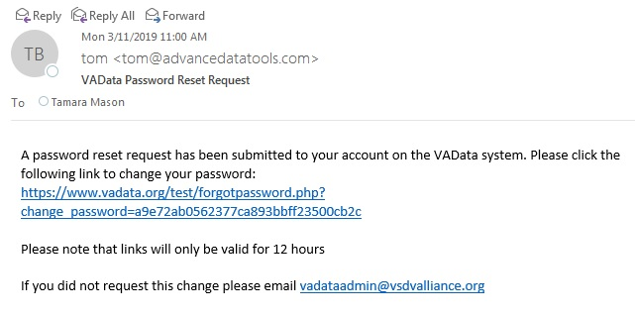
What Happens Next?
Next, you agency’s designated VAdata contact person will get an email that looks something like this:

Slide 11
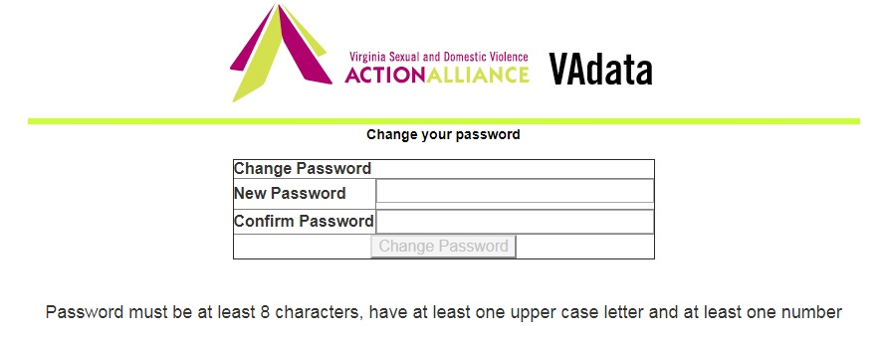
Once you click the link, it will bring you to a page where you can enter the new password.
You will notice that new passwords must be at least eight (8) characters long and include at least one (1) capital letter and one (1) number. Feel free to be creative.

Slide 12
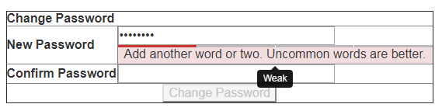
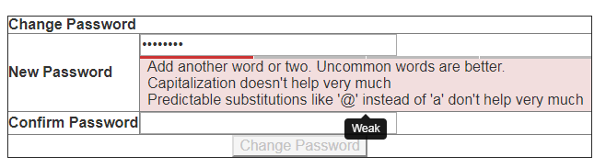
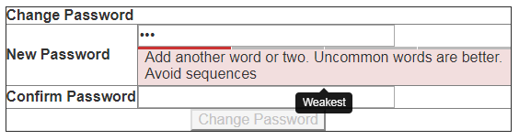
The system may offer “suggestions” for your new password:
These are only suggestions. The only rule is the 8 characters, 1 upper case, and 1 number minimums.

Slide 13

Now you can start using your new password when you log into VAdata!

Slide 14
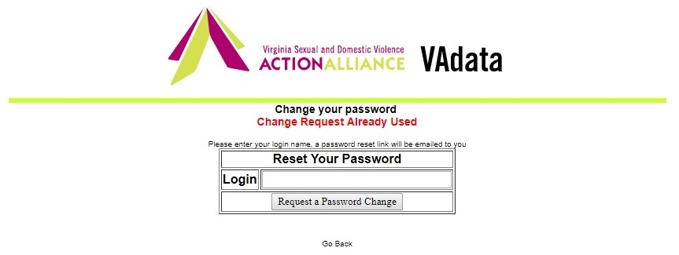
What Happens if the Link has Already Been Used?
If the link has already been used and the password has already been reset, you will see a message like this:
This means you’ve likely already reset the password using that link. If you forgot the new password or if you need to change it again, you will need to submit a new change request.

Slide 15
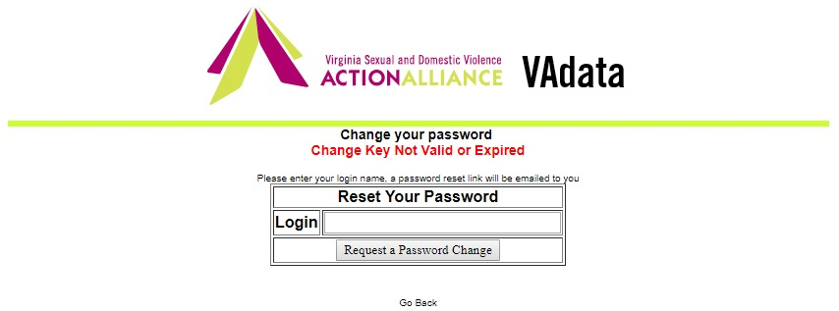
What Happens if I Wait Too Long to Use the Link?
If you wait too long to use the reset link, you will get a message like this:
You will need to resend your request and use the new link sent via email.

Slide 16
What Happens if the VAdata Contact Person or Director is Unavailable?
Password change requests can still be made through the VAdata Admin staff at the Action Alliance.
Only in cases of urgent need should the Action Alliance be contacted to make these changes. Otherwise, please wait until your agency’s VAdata contact person or Director is able to check their email and follow the steps outlined.

Slide 17
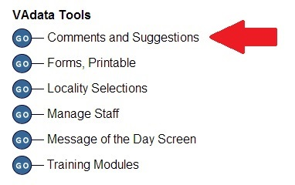
Comments and Suggestions​
This is an online bulletin board where you can post comments/suggestions and where you can read what others have posted. ​
This is a great place to make a suggestion or request support that does not need immediate attention.​
If you need immediate attention, please give us a call. Often we will need additional information from you, so a call is usually more expedient than an email.​

Slide 18
If you have questions or problems:
Many changes were made to the VAdata system. In that process, the VAdata staff may have made some unintentional errors. If the system is not operating as you expect, please do not hesitate to contact us. You may be able to help us identify a problem that needs to be fixed.
If you have any questions about any changes (or anything else related to VAdata), please contact us!
Call 804.377.0335 to contact us by phone or vadataadmin@vsdvalliance.org .

Slide 19
Vadata’s Working But I Still Need Help!
Who do I contact?
Tamara Mason,
SDVA Data System Manager
tmason@vsdvalliance.org or
804.377.0335

